Slide 1

CSG1105 / CSG5130
Applied Communications
Chapter 6
Network Design and Troubleshooting Scenarios

Slide 2
Objectives
Discuss several considerations that must be made when networking computers together, from just two computers, to several computers in a lab, and all the computers in a business
Discuss the different ways remote access is provided to a network
Estimate the hardware components needed for a specific network

Slide 3
Objectives (cont’d.)
Describe the importance of determining a baseline utilization of network traffic
Discuss some initial steps to take when troubleshooting a network
Describe some of the issues related to performing a network upgrade

Slide 4
Networking Two Computers
Several ways to connect computers
  Direct cable
    Least expensive
    Windows 9x or Windows XP uses serial, parallel cable

Slide 5
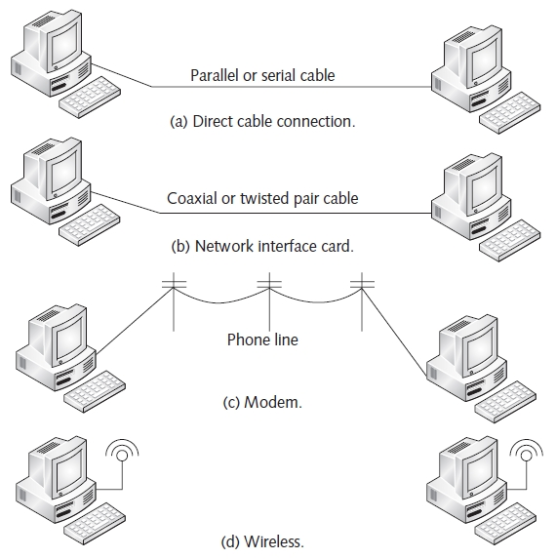
Networking Two Computers (cont’d.)
Figure 6-1 Connecting two computers

Slide 6
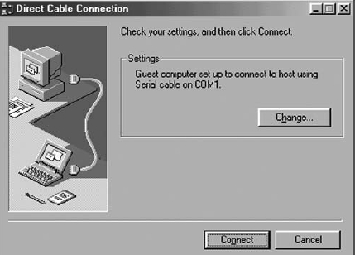
Networking Two Computers (cont’d.)
Host computer provides resources
Guest computer wants access over the connection
Switch between Guest mode and Host mode
  Left-click the Change tab
Figure 6-2(a) Direct Cable Connection
window using Windows 9x

Slide 7
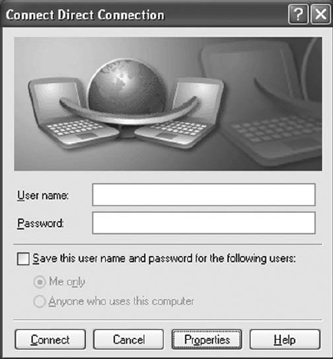
Networking Two Computers (cont’d.)
Windows XP requires username and password
Properties button
  Access configuration options
Figure 6-2(b) Direct Cable Connection
window using Windows XP

Slide 8
Networking Two Computers (cont’d.)
Windows Vista
  No support for direct cable connection option
  Uses wireless networking and USB connectivity
Network interface cards
  Less expensive than modems
  No hub required to connect two computers
    Use crossover cable (10/100baseT)
Modems offer slowest connection speed
  Useful for connection over a large distance
  Uses PSTN (public switched telephone network)

Slide 9
Networking a Small Lab
Requirements for networking small laboratory
  Two possibilities
    Use one or more hubs or switches (10/100baseT)
    Use coax (10Base2)
Hubs and switches
  More expensive than coax
  Advantages over coax
    Better speed, connections
  Switches
    Establish a network hierarchy, guarantee bandwidth

Slide 10
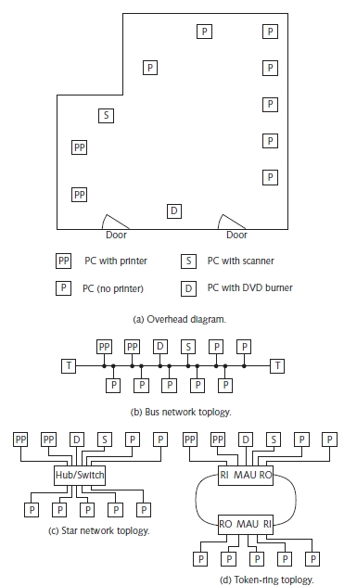
Figure 6-3 A small laboratory

Slide 11
Networking a Small Lab (cont’d.)
Coaxial cable
  Used in the early days of Ethernet
  Saved on hardware costs
  Required more installation time
IBM mainframe environment
  Token-ring network
    Required one or more MAUs, STP cables
  See Figures 6-3(b) through 6-3(d)

Slide 12
Networking a Small Lab (cont’d.)
Network software must be configured
  Windows machines with built-in networking support
    Automatically communicate over the network via TCP/IP
    Static address assignment: Class C address range of 192.168.xxx.xxx
    Default dynamic assignment: Class B address range starting with 169.254.x.x
  Linux environment, other environments
    Both static and dynamic TCP/IP addressing used

Slide 13
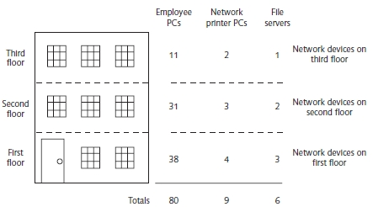
Networking a Small Business
Requires hybrid network
  Hubs and/or switches group bunches of PCs together
  UTP or fiber optic cable connect hubs or switches
  Switches
    Relieve traffic congestion, allow repartitioning
Figure 6-4 A small business

Slide 14
Networking a Small Business (cont’d.)
Reasons coax not used to wire entire building
  Requires segments connected with repeaters
  95 pairs of crimps necessary to daisy chain link all machines (disaster if one crimp fails)
  Speed: 106,000 bits/second per machine (or less)
Switch-based topologies
  Could guarantee 10/100 Mbps to each machine
Heavily data dependent business
  Connect each floor via fiber
    Utilize Fast or Gigabit Ethernet technology
    Fiber switch or fiber ring topology

Slide 15
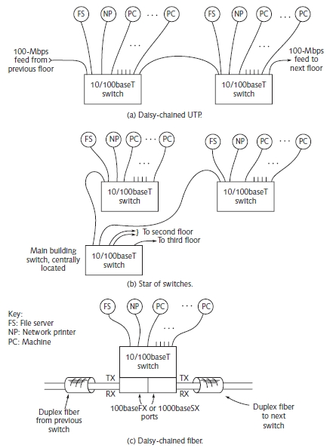
Figure 6-5 Sample network topologies for office building

Slide 16
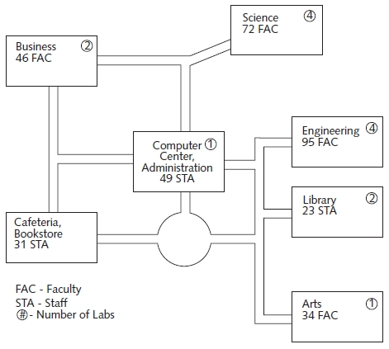
Networking a College Campus
Figure 6-6 A college campus
Example: 14 laboratories
  16 machines, standalone network printer each
  Number of labs circled
  Faculty and staff connected

Slide 17
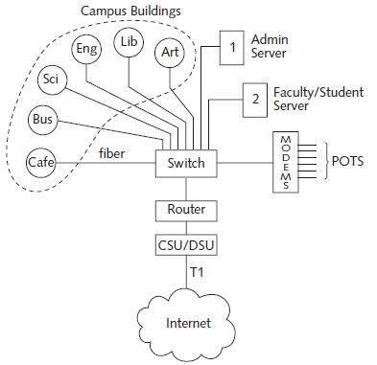
Networking a College Campus
Computer Center
  Each building connects to a central communications rack
  Pair of fibers (duplex cable) from each building plug into a 100-Mbps fiber switch
Figure 6-7 Computer Center network diagram

Slide 18
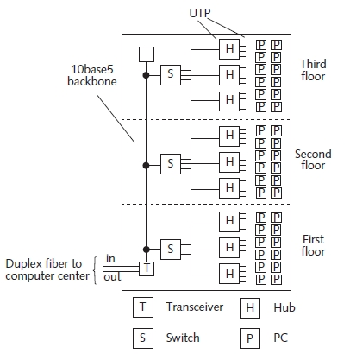
Networking a College Campus
Original network layout (typical campus building)
  Fiber transceivers
    Convert between fiber and 10base5 coaxial backbone
  Switch on each floor isolates traffic
Figure 6-8 Network structure of a
typical campus building

Slide 19
Networking a College Campus (cont’d.)
Central communications rack switch
  Provides hierarchy between administration and faculty/student mainframes
  Router connected to switch performs gateway duties
  Connects to a modem bank
Results
  Few IP addresses for future expansion
  Network speed limited to 10 Mbps

Slide 20
Networking a College Campus (cont’d.)
Proposed solution
  Replace fiber-to-10base5 transceiver with a fiber-to-100baseT switch
    Feed each floor with its own 100baseT cable
  Replace all hubs with 10/100baseT switches
  Install new 10/100baseT NICs in selected machines
Accepted solution
  Fiber to each floor, a gigabit backbone, and an additional T1 line

Slide 21
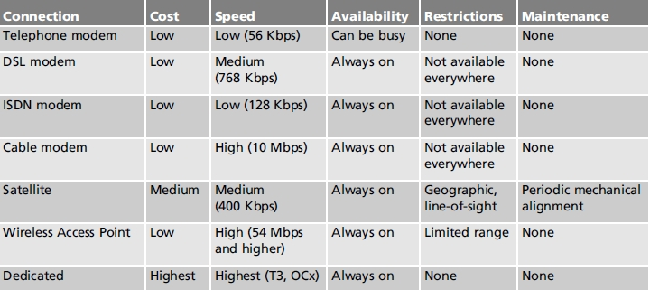
Remote Access Methods
Provide access to public and private networks and the Internet
Table 6-1 Remote access connection methods

Slide 22
Remote Access Methods (cont’d.)
DSL (Digital Subscriber Line)
  Increasingly popular for individuals
  Dedicated connection “always on” feature
    Fraction of cost of a T1 line; reasonable speed
ADSL (Asymmetric DSL)
  Upstream bandwidth lower than downstream bandwidth
DSLAM (DSL Access Multiplexer)
  Key component in Central Office
  Manages voice and data traffic
    Between residential user, PSTN switch, ISP

Slide 23
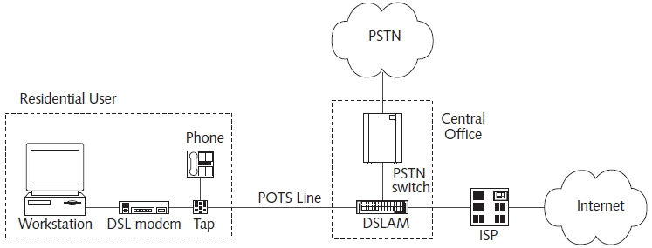
Remote Access Methods (cont’d.)
Figure 6-9 DSL architecture from home to Central Office

Slide 24
Remote Access Methods (cont’d.)
Wireless networking example (see Figure 6-10)
  Seminar room wireless access point (WAP)
    Connected to campus network
    Provides up to ten simultaneous wireless connections
    150 feet indoor range (400 feet outdoor range)
  30 foot wide rooms
  Ten foot wide hallway
  Four laptops configured same way
Wireless laptops C, D cannot establish connection to the WAP
  Cause: nature of the environment

Slide 25
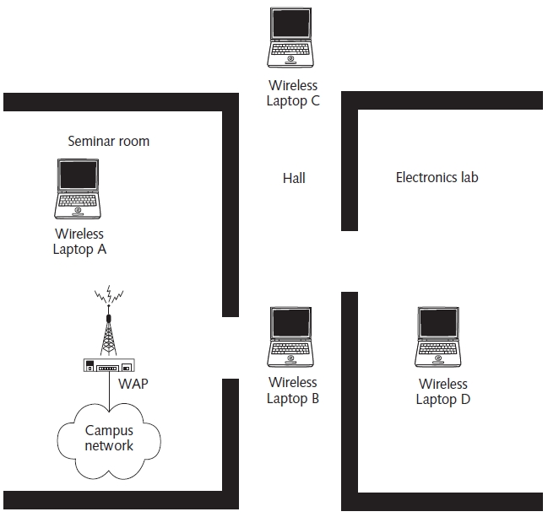
Remote Access Methods (cont’d.)
Figure 6-10 Overhead view of wireless network

Slide 26
Troubleshooting Techniques
Monitor network baseline utilization
  Provides a feel for “normal” operation
  Helps identify problem source
Checking the hardware
  Check System Properties window
  Review list of installed hardware
  Never assume everything is connected properly

Slide 27
Troubleshooting Techniques (cont’d.)
Using test equipment
  Helpful for really difficult hardware problems
  Cable tester (UTP), time domain reflectometer (TDR) for coax, optical TDR (for fiber), network analyzer
What’s My IP?
  Check network connection status to determine IP address
    Use Network Connection Details window (Windows XP)

Slide 28
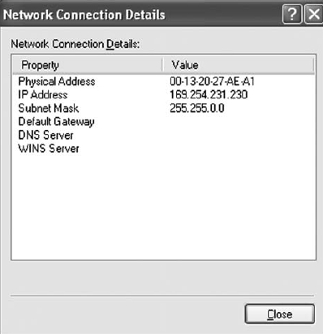
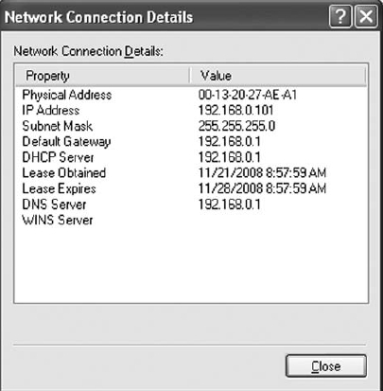
Troubleshooting Techniques (cont’d.)
Figure 6-11(a) Network Connection
Details display: Invalid network
information
Figure 6-11(b) Network Connection
Details display: Valid network
information

Slide 29
Troubleshooting Techniques (cont’d.)
Check the Network Neighborhood
  Verify machine properly networked
  Open My Network Places
    Shows network hosts sharing resources
Can You PING?
  Successfully PINGing network host
    Proves network hardware and software operating correctly
  Successful PING of host using its IP address but not its domain name
    Possible problem with DNS server

Slide 30
Summary
Connecting computers
  Easily accomplished in several ways
    Direct cable connection
    Network interface cards
    Modems
    Wireless Communication
Large computer networks
  Use a combination of networking technologies
Troubleshooting network problems requires time, patience, and logical thinking

